Slide 1
Clustering

Slide 2
Lecture outline
Distance/Similarity between data objects
Data objects as geometric data points
Clustering problems and algorithms
  K-means
  K-median
  K-center

Slide 3
What is clustering?
A grouping of data objects such that the objects within a group are similar (or related) to one another and different from (or unrelated to) the objects in other groups
Inter-cluster distances are maximized
Intra-cluster distances are minimized

Slide 4
Outliers
Outliers are objects that do not belong to any cluster or form clusters of very small cardinality
In some applications we are interested in discovering outliers, not clusters (outlier analysis)
cluster
outliers

Slide 5
Why do we cluster?
Clustering : given a collection of data objects group them so that
  Similar to one another within the same cluster
  Dissimilar to the objects in other clusters
Clustering results are used:
  As a stand-alone tool to get insight into data distribution
    Visualization of clusters may unveil important information
  As a preprocessing step for other algorithms
    Efficient indexing or compression often relies on clustering

Slide 6
Applications of clustering?
Image Processing
  cluster images based on their visual content
Web
  Cluster groups of users based on their access patterns on webpages
  Cluster webpages based on their content
Bioinformatics
  Cluster similar proteins together (similarity wrt chemical structure and/or functionality etc)
Many more…

Slide 7
The clustering task
Group observations into groups so that the observations belonging in the same group are similar, whereas observations in different groups are different
Basic questions:
  What does “similar” mean
  What is a good partition of the objects? I.e., how is the quality of a solution measured
  How to find a good partition of the observations

Slide 8
Observations to cluster
Real-value attributes/variables
  e.g., salary, height
Binary attributes
  e.g., gender (M/F), has_cancer(T/F)
Nominal (categorical) attributes
  e.g., religion (Christian, Muslim, Buddhist, Hindu, etc.)
Ordinal/Ranked attributes
  e.g., military rank (soldier, sergeant, lutenant, captain, etc.)
Variables of mixed types
  multiple attributes with various types

Slide 9
Observations to cluster
Usually data objects consist of a set of attributes (also known as dimensions)
J. Smith, 20, 200K
If all d dimensions are real-valued then we can visualize each data point as points in a d-dimensional space
If all d dimensions are binary then we can think of each data point as a binary vector

Slide 10
Distance functions
The distance d(x, y) between two objects xand y is a metric if
  d(i, j)≥0 (non-negativity)
  d(i, i)=0 (isolation)
  d(i, j)= d(j, i) (symmetry)
  d(i, j) ≤ d(i, h)+d(h, j) (triangular inequality) [Why do we need it?]
The definitions of distance functions are usually different for real, boolean, categorical, and ordinal variables.
Weights may be associated with different variables based on applications and data semantics.

Slide 11
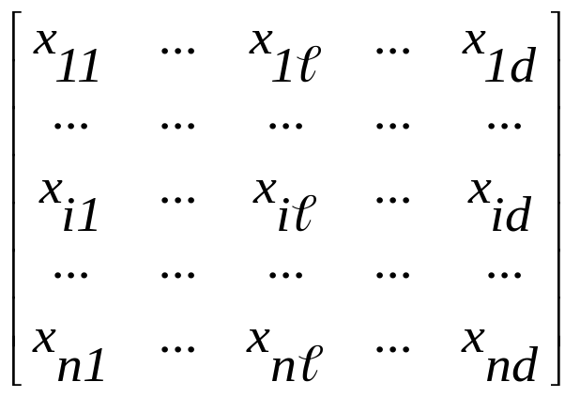

Data Structures
attributes/dimensions
data matrix
Distance matrix
tuples/objects
objects
objects

Slide 12
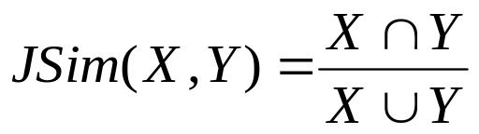
Distance functions for binary vectors
Jaccard similarity between binary vectors X and Y
Jaccard distance between binary vectors X and Y
Jdist(X,Y) = 1- JSim(X,Y)
Example:
  JSim = 1/6
  Jdist = 5/6
 | Q1 | Q2 | Q3 | Q4 | Q5 | Q6
X | 1 | 0 | 0 | 1 | 1 | 1
Y | 0 | 1 | 1 | 0 | 1 | 0

Slide 13
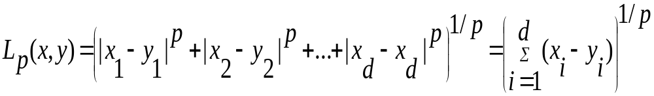
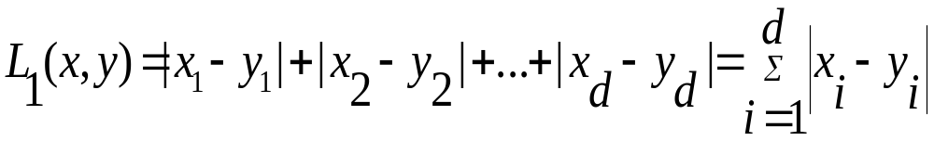
Distance functions for real-valued vectors
L_{p} norms or Minkowski distance:
  where p is a positive integer
If p = 1, L₁ is the Manhattan (or city block) distance:

Slide 14
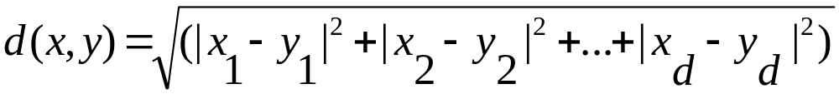
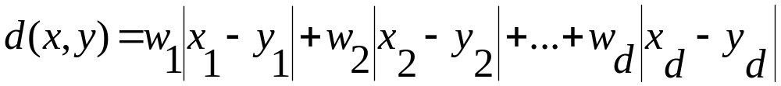
Distance functions for real-valued vectors
If p = 2, L₂ is the Euclidean distance:
Also one can use weighted distance:
Very often L_{p}^{p} is used instead of L_{p} (why?)

Slide 15
Partitioning algorithms: basic concept
Construct a partition of a set of n objects into a set of k clusters
  Each object belongs to exactly one cluster
  The number of clusters k is given in advance

Slide 16
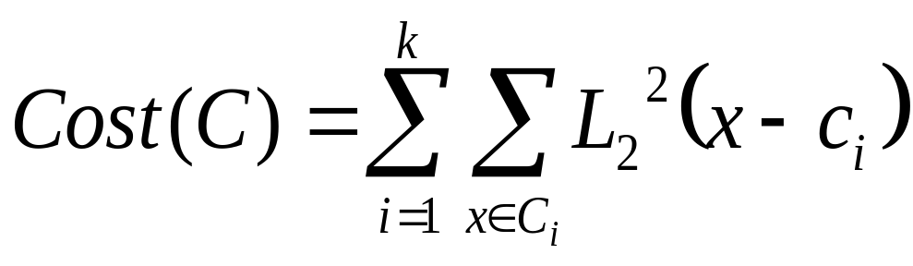
The k-means problem
Given a set X of n points in a d-dimensional space and an integer k
Task: choose a set of k points {c₁, c₂,…,c_{k}} in the d-dimensional space to form clusters {C₁, C₂,…,C_{k}} such that
is minimized
Some special cases: k = 1, k = n

Slide 17
Algorithmic properties of the k-means problem
NP-hard if the dimensionality of the data is at least 2 (d>=2)
Finding the best solution in polynomial time is infeasible
For d=1 the problem is solvable in polynomial time (how?)
A simple iterative algorithm works quite well in practice

Slide 18
The k-means algorithm
One way of solving the k-means problem
Randomly pick k cluster centers {c₁,…,c_{k}}
For each i, set the cluster C_{i} to be the set of points in X that are closer to c_{i} than they are to c_{j} for all i≠j
For each i let c_{i} be the center of cluster C_{i} (mean of the vectors in C_{i})
Repeat until convergence

Slide 19
Properties of the k-means algorithm
Finds a local optimum
Converges often quickly (but not always)
The choice of initial points can have large influence in the result

Slide 20



Two different K-means Clusterings
Original Points
Optimal Clustering
Sub-optimal Clustering

Slide 21
Discussion k-means algorithm
Finds a local optimum
Converges often quickly (but not always)
The choice of initial points can have large influence
  Clusters of different densities
  Clusters of different sizes
Outliers can also cause a problem (Example?)

Slide 22
Some alternatives to random initialization of the central points
Multiple runs
  Helps, but probability is not on your side
Select original set of points by methods other than random . E.g., pick the most distant (from each other) points as cluster centers (kmeans++ algorithm)

Slide 23
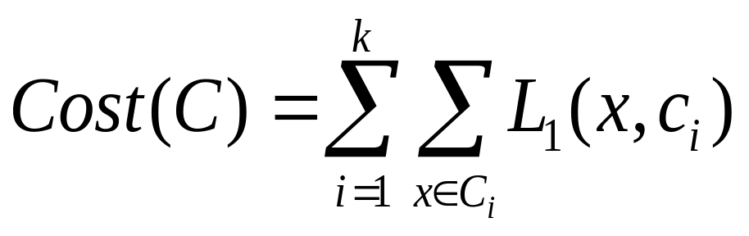
The k-median problem
Given a set X of n points in a d-dimensional space and an integer k
Task: choose a set of k points {c₁,c₂,…,c_{k}} from X and form clusters {C₁,C₂,…,C_{k}} such that
is minimized

Slide 24
The k-medoids algorithm
Or … PAM (Partitioning Around Medoids, 1987)
  Choose randomly k medoids from the original dataset X
  Assign each of the n-k remaining points in X to their closest medoid
  iteratively replace one of the medoids by one of the non-medoids if it improves the total clustering cost

Slide 25
Discussion of PAM algorithm
The algorithm is very similar to the k-means algorithm
It has the same advantages and disadvantages
How about efficiency?

Slide 26
CLARA (Clustering Large Applications)
It draws multiple samples of the data set, applies PAM on each sample, and gives the best clustering as the output
Strength: deals with larger data sets than PAM
Weakness:
  Efficiency depends on the sample size
  A good clustering based on samples will not necessarily represent a good clustering of the whole data set if the sample is biased

Slide 27
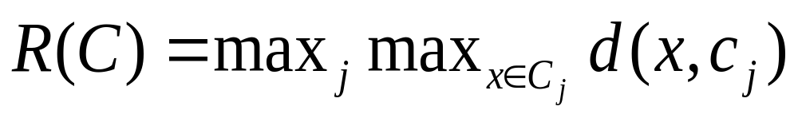
The k-center problem
Given a set X of n points in a d-dimensional space and an integer k
Task: choose a set of k points from X as cluster centers {c₁,c₂,…,c_{k}} such that for clusters {C₁,C₂,…,C_{k}}
is minimized

Slide 28
Algorithmic properties of the k-centers problem
NP-hard if the dimensionality of the data is at least 2 (d>=2)
Finding the best solution in polynomial time is infeasible
For d=1 the problem is solvable in polynomial time (how?)
A simple combinatorial algorithm works well in practice

Slide 29
The farthest-first traversal algorithm
Pick any data point and label it as point 1
For i=2,3,…,n
  Find the unlabelled point furthest from {1,2,…,i-1} and label it as i.
  //Use d(x,S) = min_{yєS} d(x,y) to identify the distance //of a point from a set
  π(i) = argmin_{j<i}d(i,j)
  R_{i}=d(i,π(i))

Slide 30
The farthest-first traversal is a 2-approximation algorithm
Claim1: R₁≥R₂ ≥… ≥R_{n}
Proof:
  R_{j}=d(j,π(j)) = d(j,{1,2,…,j-1})
  ≤d(j,{1,2,…,i-1}) //j > i
  ≤d(i,{1,2,…,i-1}) = R_{i}

Slide 31
The farthest-first traversal is a 2-approximation algorithm
Claim 2: If C is the clustering reported by the farthest algorithm, then R(C)=R_{k+1}
Proof:
  For all i > k we have that
  d(i, {1,2,…,k})≤ d(k+1,{1,2,…,k}) = R_{k+1}

Slide 32
The farthest-first traversal is a 2-approximation algorithm
Theorem: If C is the clustering reported by the farthest algorithm, and C*is the optimal clustering, then then R(C)≤2xR(C*)
Proof:
  Let C*₁, C*₂,…, C*_{k} be the clusters of the optimal k-clustering.
  If these clusters contain points {1,…,k} then R(C)≤ 2R(C*) (triangle inequality)
  Otherwise suppose that one of these clusters contains two or more of the points in {1,…,k}. These points are at distance at least R_{k} from each other. Thus clusters must have radius
  ½ R_{k} ≥ ½ R_{k+1}= ½ R(C)

Slide 33
What is the right number of clusters?
…or who sets the value of k?
For n points to be clustered consider the case where k=n. What is the value of the error function
What happens when k = 1?
Since we want to minimize the error why don’t we select always k = n?

Slide 34
Occam’s razor and the minimum description length principle
Clustering provides a description of the data
For a description to be good it has to be:
  Not too general
  Not too specific
Penalize for every extra parameter that one has to pay
Penalize the number of bits you need to describe the extra parameter
So for a clustering C, extend the cost function as follows:
NewCost(C) = Cost( C ) + |C| x logn

